Slide 1
CS162 Operating Systems and Systems Programming Lecture 6 Concurrency (Continued), Thread and Processes
September 12, 2018
Prof. Ion Stoica
http://cs162.eecs.Berkeley.edu

Slide 2
Recall: Dispatch Loop
Conceptually, the dispatching loop of the operating system looks as follows:
Loop {
RunThread();
newTCB = ChooseNextThread();
SaveStateOfCPU(curTCB);
LoadStateOfCPU(newTCB);
}
This is an infinite loop
One could argue that this is all that the OS does
Should we ever exit this loop???
When would that be?
Notes:
Emergency crash of operating system called “panic()”

Slide 3
Running a thread
Consider:
RunThread()
…
LoadStateOfCPU(newTCB)
How do I run a thread?
Load its state (registers, PC, stack pointer) into CPU
Load environment (virtual memory space, etc)
Jump to the PC
How does the dispatcher get control back?
Internal events: thread returns control voluntarily
External events: thread gets preempted
Notes:
OS’s have almost human characteristics – unpredictable, hard to understand, …
Different things share the same CPU – one thread, then another
Similar to schizophrenia, like the movie Sybil, one body shared by several people, say we start with Dave Patterson
Threads are like the personalities of the CPU. First one thread/personality uses the CPU, then another,…

Slide 4
Internal Events
Blocking on I/O
The act of requesting I/O implicitly yields the CPU
Waiting on a “signal” from other thread
Thread asks to wait and thus yields the CPU
Thread executes a yield()
Thread volunteers to give up CPU
computePI() {
while(TRUE) {
ComputeNextDigit();
yield();
}
}
Notes:
Yield is for really nice people – Ever see two people at the supermarket checkout line? You first, no you first, …

Slide 5
Stack for Yielding Thread
ComputePI
yield
Trap to OS
kernel_yield
Stack growth
run_new_thread
switch
How do we run a new thread?
run_new_thread() {
newThread = PickNewThread();
switch(curThread, newThread);
ThreadHouseKeeping(); /* Do any cleanup */
}
How does dispatcher switch to a new thread?
Save anything next thread may trash: PC, regs, stack pointer
Maintain isolation for each thread

Slide 6
What Do the Stacks Look Like?
Consider the following code blocks:
proc A() {
B();
}
proc B() {
while(TRUE) {
yield();
}
}
Suppose we have 2 threads running same code:
Threads S and T
Thread S
Thread T
A
A
B(while)
B(while)
Stack growth
yield
yield
run_new_thread
run_new_thread
switch
switch

Slide 7
Saving/Restoring state (often called “Context Switch)
switch(tCur,tNew) {
/* Unload old thread */
TCB[tCur].regs.r7 = CPU.r7;
…
TCB[tCur].regs.r0 = CPU.r0;
TCB[tCur].regs.sp = CPU.sp;
TCB[tCur].regs.retpc = CPU.retpc; /*return addr*/
/* Load and execute new thread */
CPU.r7 = TCB[tNew].regs.r7;
…
CPU.r0 = TCB[tNew].regs.r0;
CPU.sp = TCB[tNew].regs.sp;
CPU.retpc = TCB[tNew].regs.retpc;
return; /* Return to CPU.retpc */
}

Slide 8
Switch Details (continued)
What if you make a mistake in implementing switch?
Suppose you forget to save/restore register 32
Get intermittent failures depending on when context switch occurred and whether new thread uses register 32
System will give wrong result without warning
Can you devise an exhaustive test to test switch code?
No! Too many combinations and inter-leavings
Cautionary tale:
For speed, Topaz kernel saved one instruction in switch()
Carefully documented! Only works as long as kernel size < 1MB
What happened?
Time passed, People forgot
Later, they added features to kernel (no one removes features!)
Very weird behavior started happening
Moral of story: Design for simplicity

Slide 9
Some Numbers
Frequency of performing context switches: 10-100ms
Context switch time in Linux: 3-4 μsecs (Intel i7 & E5)
Thread switching faster than process switching (100 ns)
But switching across cores ~2x more expensive than within-core
Context switch time increases sharply with size of working set*
Can increase 100x or more *The working set is subset of memory used by process in a time window
Moral: context switching depends mostly on cache limits and the process or thread’s hunger for memory

Slide 10
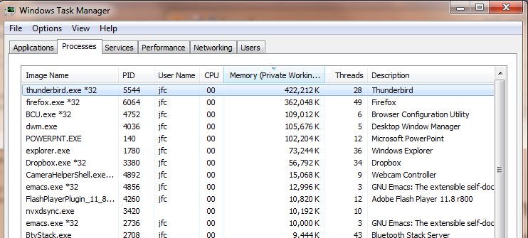
Some Numbers
Many process are multi-threaded, so thread context switches may be either within-process or across-processes

Slide 11
What happens when thread blocks on I/O?
CopyFile
read
Trap to OS
Stack growth
kernel_read
run_new_thread
switch
What happens when a thread requests a block of data from the file system?
User code invokes a system call
Read operation is initiated
Run new thread/switch
Thread communication similar
Wait for Signal/Join
Networking

Slide 12
External Events
What happens if thread never does any I/O, never waits, and never yields control?
Could the ComputePI program grab all resources and never release the processor?
What if it didn’t print to console?
Must find way that dispatcher can regain control!
Answer: utilize external events
Interrupts: signals from hardware or software that stop the running code and jump to kernel
Timer: like an alarm clock that goes off every some milliseconds
If we make sure that external events occur frequently enough, can ensure dispatcher runs
Notes:
Patterson’s a nice guy, so he gives up the body after using it for awhile and let’s John Kubitowicz have it.
But Kubi’s not so nice, so he won’t give up control…
If you want to wake up for a final, you set your clock, or ask your roommate to pour water over your head – OS does the same

Slide 13
Example: Network Interrupt
Raise priority
Reenable All Ints
Save registers
Dispatch to Handler
…
Transfer Network Packet from hardware to Kernel Buffers
…
Restore registers
Clear current Int
Disable All Ints
Restore priority
RTI
...
add $r1,$r2,$r3
subi $r4,$r1,#4
slli $r4,$r4,#2
...
PC saved
Disable All Ints
Kernel Mode
External Interrupt
Pipeline Flush
“Interrupt Handler”
...
lw $r2,0($r4)
lw $r3,4($r4)
add $r2,$r2,$r3
sw 8($r4),$r2
...
Restore PC
Enable all Ints
User Mode
An interrupt is a hardware-invoked context switch
No separate step to choose what to run next
Always run the interrupt handler immediately

Slide 14
Use of Timer Interrupt to Return Control
Solution to our dispatcher problem
Use the timer interrupt to force scheduling decisions
Timer Interrupt routine:
TimerInterrupt() { DoPeriodicHouseKeeping(); run_new_thread(); }
Some Routine
Interrupt
TimerInterrupt
Stack growth
run_new_thread
switch

Slide 15
Thread Abstraction
Illusion: Infinite number of processors
Notes:
Execution model: each thread runs on a dedicated virtual processor with unpredictable and variable speed.

Slide 16
Thread Abstraction
Illusion: Infinite number of processors
Reality: Threads execute with variable speed
Programs must be designed to work with any schedule
Notes:
Execution model: each thread runs on a dedicated virtual processor with unpredictable and variable speed.

Slide 17
Programmer vs. Processor View

Slide 18
Programmer vs. Processor View

Slide 19
Programmer vs. Processor View

Slide 20
Possible Executions

Slide 21
Thread Lifecycle

Slide 22
Administrivia
Your section is your home for CS162
The TA needs to get to know you to judge participation
All design reviews will be conducted by your TA
You can attend alternate section by same TA, but try to keep the amount of such cross-section movement to a minimum
First midterm: Monday, October 1, 5:00-6:30pm

Slide 23
Break

Slide 24
Per Thread Descriptor (Kernel Supported Threads)
Each Thread has a Thread Control Block (TCB)
Execution State: CPU registers, program counter (PC), pointer to stack (SP)
Scheduling info: state, priority, CPU time
Various Pointers (for implementing scheduling queues)
Pointer to enclosing process (PCB) – user threads
… (add stuff as you find a need)
OS Keeps track of TCBs in “kernel memory”
In Array, or Linked List, or …
I/O state (file descriptors, network connections, etc)

Slide 25
ThreadFork(): Create a New Thread
ThreadFork() is a user-level procedure that creates a new thread and places it on ready queue
Arguments to ThreadFork()
Pointer to application routine (fcnPtr)
Pointer to array of arguments (fcnArgPtr)
Size of stack to allocate
Implementation
Sanity check arguments
Enter Kernel-mode and Sanity Check arguments again
Allocate new Stack and TCB
Initialize TCB and place on ready list (Runnable)

Slide 26
How do we initialize TCB and Stack?
Initialize Register fields of TCB
Stack pointer made to point at stack
PC return address ⇒ OS (asm) routine ThreadRoot()
Two arg registers (a0 and a1) initialized to fcnPtr and fcnArgPtr, respectively
Initialize stack data?
No. Important part of stack frame is in registers (ra)
Think of stack frame as just before body of ThreadRoot() really gets started
ThreadRoot stub
Stack growth
Initial Stack

Slide 27
How does Thread get started?
Other Thread
ThreadRoot
A
B(while)
Stack growth
yield
run_new_thread
New Thread
switch
ThreadRoot stub
Eventually, run_new_thread() will select this TCB and return into beginning of ThreadRoot()
This really starts the new thread

Slide 28
What does ThreadRoot() look like?
ThreadRoot() is the root for the thread routine:
ThreadRoot() {
DoStartupHousekeeping();
UserModeSwitch(); /* enter user mode */
Call fcnPtr(fcnArgPtr);
ThreadFinish();
}
Startup Housekeeping
Includes things like recording start time of thread
Other statistics
Stack will grow and shrink with execution of thread
Final return from thread returns into ThreadRoot() which calls ThreadFinish()
ThreadFinish() wake up sleeping threads
ThreadRoot
Thread Code
Stack growth
Running Stack

Slide 29
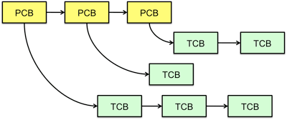
Multithreaded Processes
Process Control Block (PCBs) points to multiple Thread Control Blocks (TCBs):
Switching threads within a block is a simple thread switch
Switching threads across blocks requires changes to memory and I/O address tables

Slide 30
Examples multithreaded programs
Embedded systems
Elevators, planes, medical systems, smart watches
Single program, concurrent operations
Most modern OS kernels
Internally concurrent because have to deal with concurrent requests by multiple users
But no protection needed within kernel
Database servers
Access to shared data by many concurrent users
Also background utility processing must be done
Notes:
DB servers very important – provide “shared data” view to users.
Many users can read/write at once – how is consistency managed?

Slide 31
Example multithreaded programs (con’t)
Network servers
Concurrent requests from network
Again, single program, multiple concurrent operations
File server, Web server, and airline reservation systems
Parallel programming (more than one physical CPU)
Split program into multiple threads for parallelism
This is called Multiprocessing
Some multiprocessors are actually uniprogrammed:
Multiple threads in one address space but one program at a time

Slide 32
A Typical Use Case
Client Browser
- process for each tab
- thread to render page
- GET in separate thread
- multiple outstanding GETs
- as they complete, render
portion
Web Server
- fork process for each client connection
- thread to get request and issue response
- fork threads to read data, access DB, etc
- join and respond

Slide 33
Kernel Use Cases
Thread for each user process
Thread for sequence of steps in processing I/O
Threads for device drivers
…

Slide 34
Putting it Together: Process
(Unix) Process
A(int tmp) {
if (tmp<2)
B();
printf(tmp);
}
B() {
C();
}
C() {
A(2);
}
A(1);
…
Memory
Stack
Resources
I/O State
(e.g., file, socket contexts)
Sequential stream of instructions
CPU state (PC, SP, registers..)
Stored in OS

Slide 35
Putting it Together: Processes
Process 1
Process 2
Process N
Switch overhead: high
CPU state: low
Memory/IO state: high
Process creation: high
Protection
CPU: yes
Memory/IO: yes
Sharing overhead: high (involves at least a context switch)
Mem.
Mem.
Mem.
IO
state
IO
state
…
IO
state
CPU
state
CPU
state
CPU
state
CPU sched.
OS
1 process at a time
CPU
(1 core)

Slide 36
Putting it Together: Threads
Process 1
Process N
Switch overhead: medium
CPU state: low
Thread creation: medium
Protection
CPU: yes
Memory/IO: no
Sharing overhead: low(ish) (thread switch overhead low)
threads
threads
Mem.
Mem.
…
IO
state
…
…
IO
state
CPU
state
CPU
state
CPU
state
CPU
state
CPU sched.
OS
1 thread at a time
CPU
(1 core)

Slide 37
Kernel versus User-Mode Threads
We have been talking about kernel threads
Native threads supported directly by the kernel
Every thread can run or block independently
One process may have several threads waiting on different things
Downside of kernel threads: a bit expensive
Need to make a crossing into kernel mode to schedule
Lighter weight option: User level Threads

Slide 38
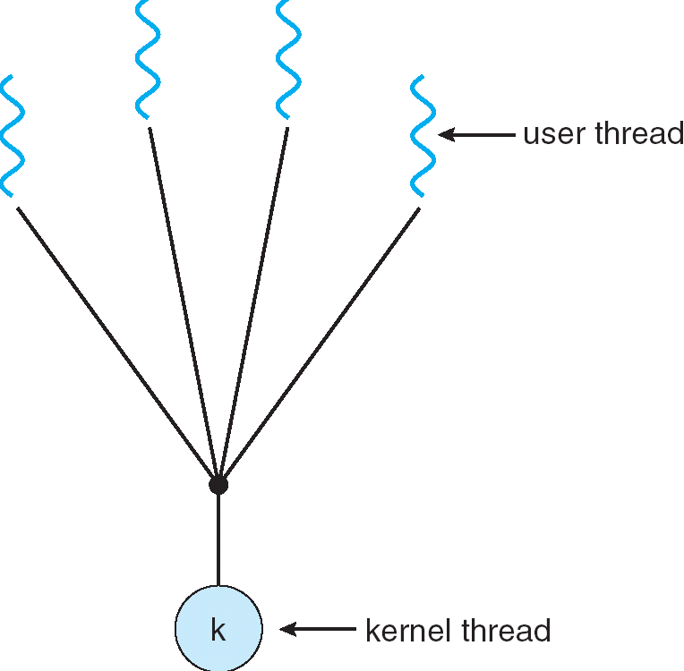
User-Mode Threads
Lighter weight option:
User program provides scheduler and thread package
May have several user threads per kernel thread
User threads may be scheduled non-preemptively relative to each other (only switch on yield())
Cheap
Downside of user threads:
When one thread blocks on I/O, all threads block
Kernel cannot adjust scheduling among all threads
Option: Scheduler Activations
Have kernel inform user level when thread blocks…

Slide 39
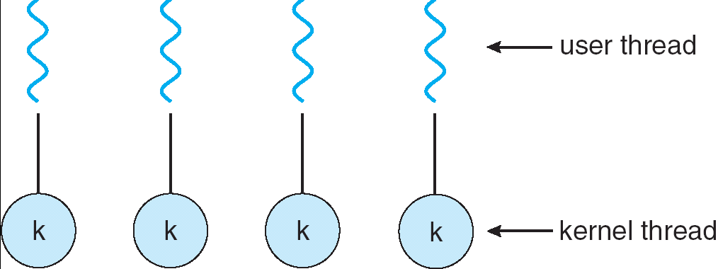
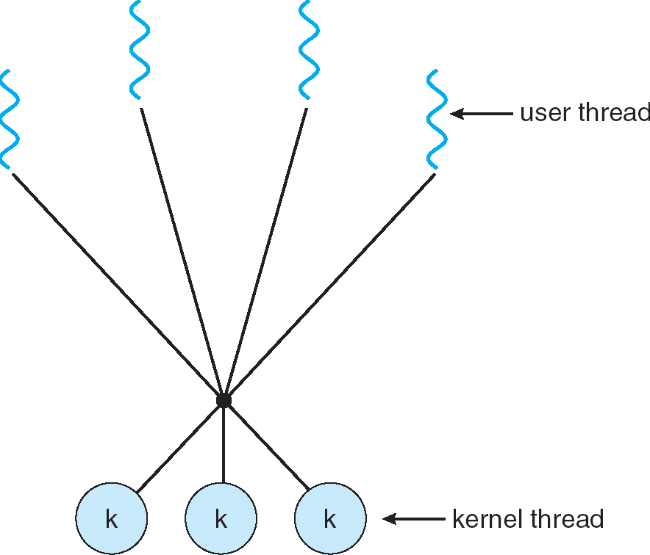
Some Threading Models
Simple One-to-One
Threading Model
Many-to-One
Many-to-Many

Slide 40
Threads in a Process
Threads are useful at user-level: parallelism, hide I/O latency, interactivity
Option A (early Java): user-level library, one multi-threaded process
Library does thread context switch
Kernel time slices between processes, e.g., on system call I/O
Option B (SunOS, Linux/Unix variants): many single-threaded processes
User-level library does thread multiplexing
Option C (Windows): scheduler activations
Kernel allocates processes to user-level library
Thread library implements context switch
System call I/O that blocks triggers upcall
Option D (Linux, MacOS, Windows): use kernel threads
System calls for thread fork, join, exit (and lock, unlock,…)
Kernel does context switching
Simple, but a lot of transitions between user and kernel mode

Slide 41
Putting it Together: Multi-Cores
Process 1
Process N
threads
threads
Switch overhead: low (only CPU state)
Thread creation: low
Protection
CPU: yes
Memory/IO: No
Sharing overhead: low (thread switch overhead low, may not need to switch at all!)
Mem.
Mem.
…
IO
state
…
…
IO
state
CPU
state
CPU
state
CPU
state
CPU
state
CPU sched.
OS
4 threads at a time
Core 1
Core 2
Core 3
Core 4
CPU

Slide 42
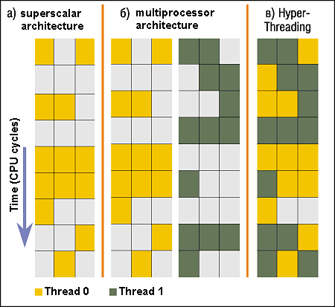
Simultaneous MultiThreading/Hyperthreading
Hardware technique
Superscalar processors can execute multiple instructions that are independent
Hyperthreading duplicates register state to make a second “thread,” allowing more instructions to run
Can schedule each thread as if were separate CPU
But, sub-linear speedup!
Original called “Simultaneous Multithreading”
http://www.cs.washington.edu/research/smt/index.html
Intel, SPARC, Power (IBM)
A virtual core on AWS’ EC2 is basically a hyperthread
Colored blocks show
instructions executed
Notes:
Intel seems to be discarding SMT in Silvermont because of power problems

Slide 43
Putting it Together: Hyper-Threading
Process 1
Process N
threads
threads
Switch overhead between hardware-threads: very-low (done in hardware)
Contention for ALUs/FPUs may hurt performance
Mem.
Mem.
…
IO
state
…
…
IO
state
CPU
state
CPU
state
CPU
state
CPU
state
CPU sched.
OS
hardware-threads
(hyperthreading)
8 threads at a time
Core 1
Core 2
Core 3
Core 4
CPU

Slide 44
Classification
One
Many
# of addr spaces:
# threads
Per AS:
One
MS/DOS, early Macintosh
Traditional UNIX
Many
Embedded systems (Geoworks, VxWorks, JavaOS,etc)
JavaOS, Pilot(PC)
Mach, OS/2, Linux
Windows 10
Win NT to XP, Solaris, HP-UX, OS X
Most operating systems have either
One or many address spaces
One or many threads per address space

Slide 45
Summary
Processes have two parts
Threads (Concurrency)
Address Spaces (Protection)
Various textbooks talk about processes
When this concerns concurrency, really talking about thread portion of a process
When this concerns protection, talking about address space portion of a process
Concurrent threads are a very useful abstraction
Allow transparent overlapping of computation and I/O
Allow use of parallel processing when available
Concurrent threads introduce problems when accessing shared data
Programs must be insensitive to arbitrary interleavings
Without careful design, shared variables can become completely inconsistent

